Slide 1

GEOGRAPHICAL ANALYSIS OF CFPB DATASET FOR JPMC Time period 2018 -2022
By – Himani Varshney

Slide 2
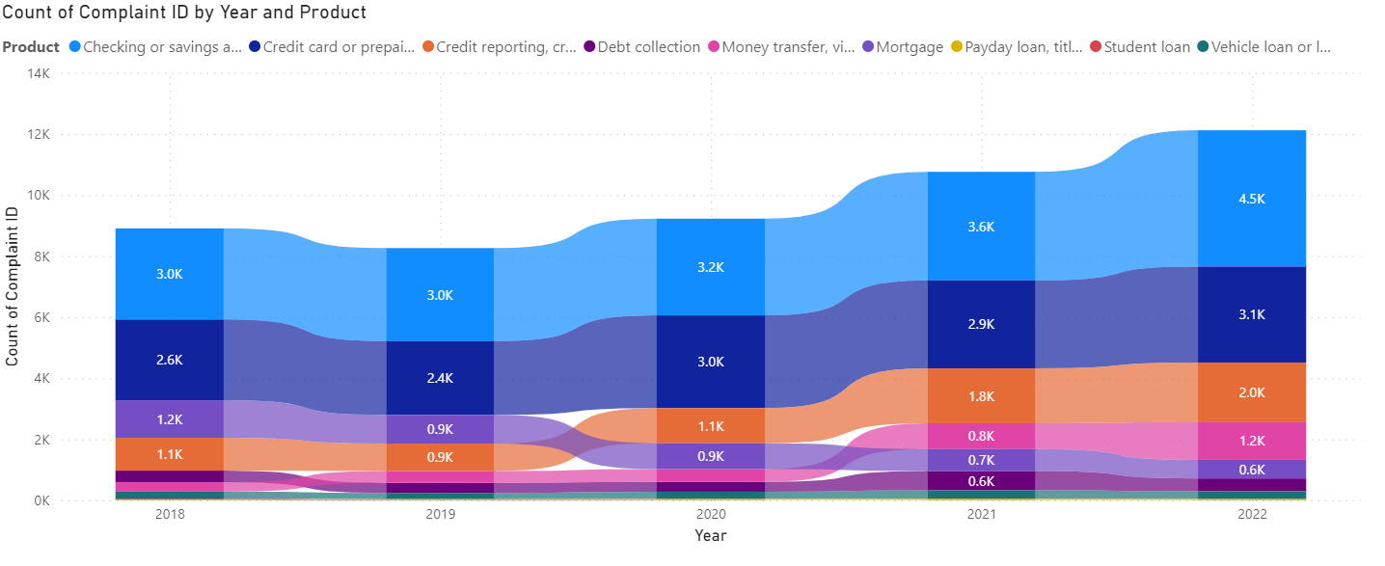
Data Metrics
CFPB dataset filtered for JPMorgan Chase : 2018 - 2022
Time period : 5 Years
49,270 complaints were registered
Increasing trend in complaints over the years.
JP Morgan ranks among the top 10 companies receiving complaints.
Analysis is required to identify issues and implement corrective actions.

Slide 3
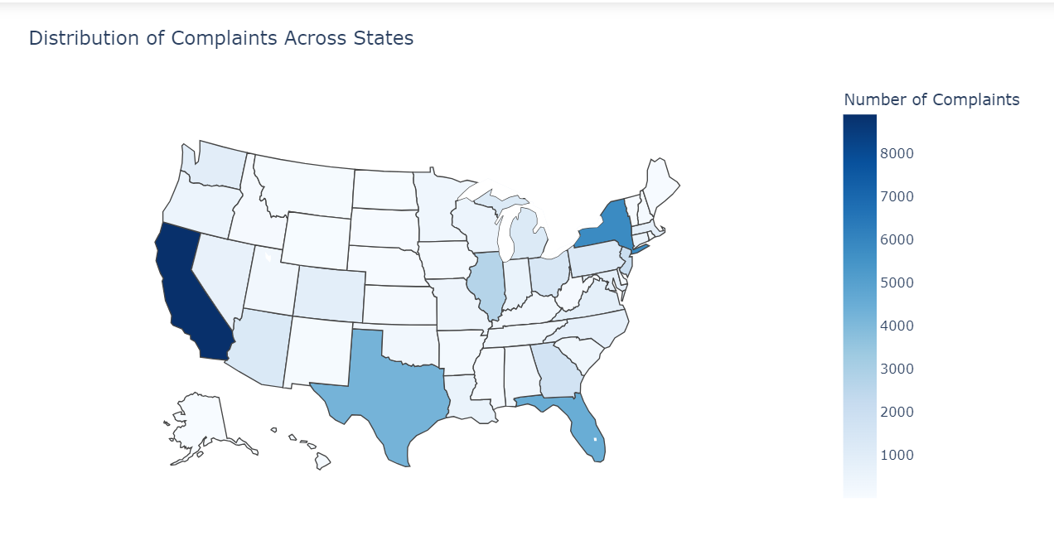
Distribution over different states
California has the maximum number of complaints registered followed by New York.

Slide 4
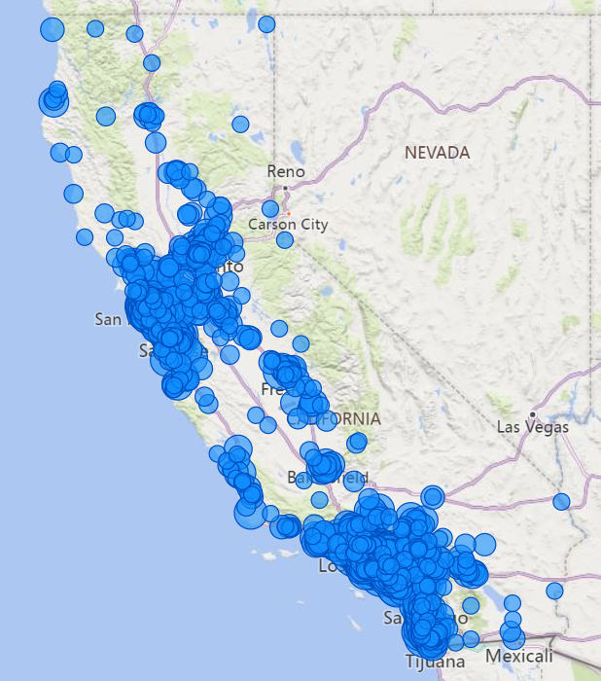
Analyzing at ZIP Code Level
Complaints in California are concentrated in San Francisco and Southern California regions.
The top 5 affected zip codes are in LA and Downtown San Jose: '90025', '90027', '90046', '95112', '90036’.
Priority actions should target these areas for maximum impact.

Slide 5
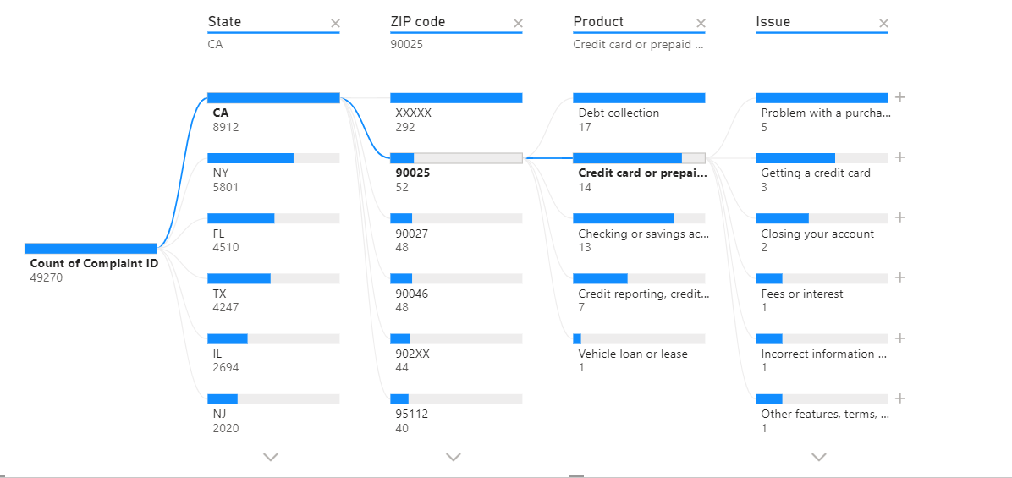
Root Cause Analysis on Top 5 Zip codes
Debt Collection, Credit card or prepaid card , and checking or savings account are the top 3 products with frequent complaints.
With respect to Credit Card or prepaid account, issues are mostly problems with a purchase, incorrect information or the fee charged.

Slide 6
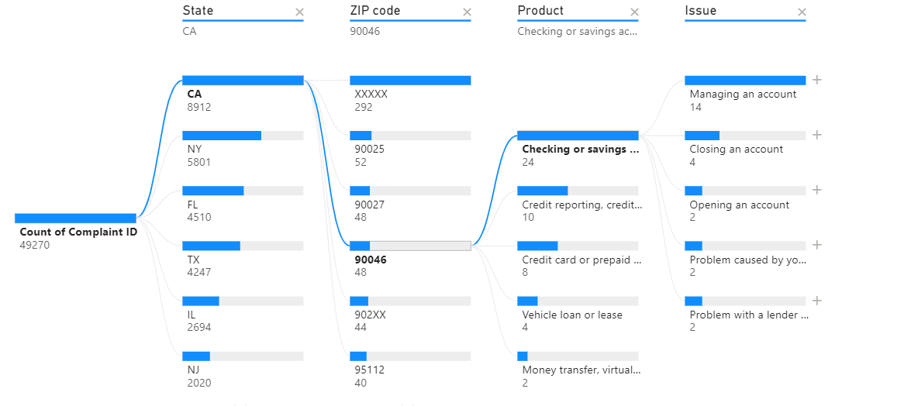
Root Cause Analysis on Top 5 Zip codes
With Checking or Savings account product, most common issues are with respect to managing an account or opening /closing an account.

Slide 7
Suggested Actions based on Geographical Analysis:
Improve Customer Support: Enhance customer support services in California by expanding call center capacity, implementing live chat support, and increasing staff training to address consumer concerns effectively.
Strengthen Consumer Education: Launch educational campaigns targeting California consumers to increase awareness of the JPMC products.
Consumers can be given a user guide with instructions on managing their savings/ checking account as well as credit cards.
Raise awareness among consumers about potential scams caused in the past.

Slide 8
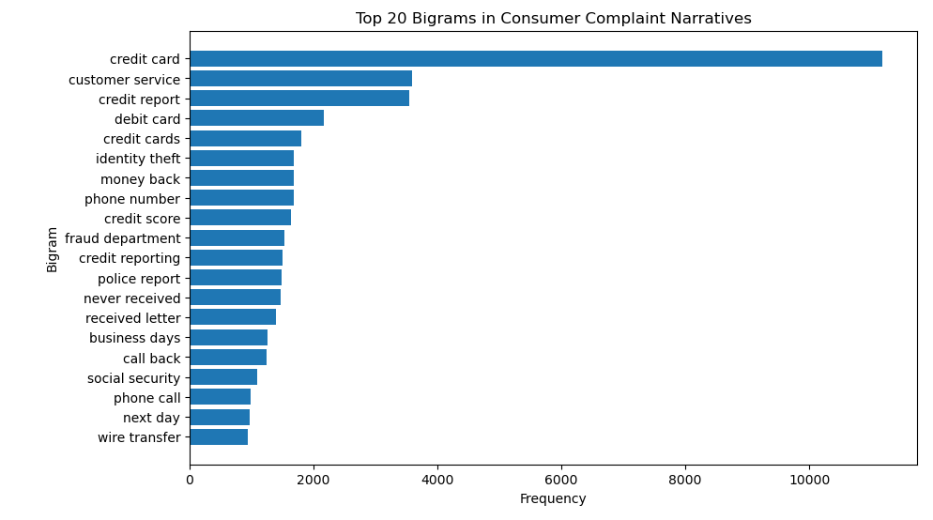
TEXT Analysis on Consumer Narratives
Terms like ‘customer service’, ‘next day’, ‘call back’ shows that customer service is not efficient, hence they filed complaints.
Terms like ‘social security’, ‘identity theft’, ‘fraud department’ shows that most people fall prey to fraud.
Terms like ‘credit cards’, ‘credit report’ and ‘credit service’ shows that customers have most issues with credit card and lack knowledge of credit reporting.
Terms like ‘never received letter’ and ‘phone number’ shows that there is a communication gap between customers and bank.

Slide 9
Actions based on TEXT Analysis
Enhance Customer Service: Improve support channels and response times (using ML).
Strengthen Fraud Prevention: Invest in technologies to detect and prevent fraud (using ML predictive and anomaly detection models).
Educate on Credit Management: Provide tools and resources for credit monitoring.
Improve Communication: Ensure timely and accurate communications.
Streamline Resolution Processes: Enhance efficiency in resolving customer complaints (using LLMs Chatbot).
Promote Security Awareness: Increase education on “social security” and “wire transfer” through trainings, campaigns etc..

Slide 10
Conclusion
The data analysis of complaints shows that JP Morgan has 49270 complaints raised in 5 years.
18.08% of complaints are raised in California followed by 11.77% in New York.
Hence these 2 states should be targeted for the suggestive actions.
Credit Card/ Prepaid card and the Savings/ Checking accounts collectively account for 63.6% of complaints.
Suggestive actions include enhancing customer service in the targeted regions, promote product awareness and strengthening fraud prevention system.

